Slide 1

Form, Note & Table Completion | Write the Right Answer Fast
Subtitle
Notes:
Form, note, and table completion questions may appear simple in the IELTS Listening test, but they are actually one of the most common sources of careless mistakes for many candidates. Because the answers are often short, test-takers sometimes focus only on hearing the information and forget to pay attention to spelling, word form, or word limits.
In this type of question, even a small mistake can cost you the mark. One missing letter, one extra word, or the wrong grammatical form may cause an otherwise correct answer to be marked incorrect. For this reason, accuracy is just as important as understanding the audio.
In this video, you will learn how to approach form, note, and table completion questions effectively, including how to listen for key information, follow the word limit, and avoid common errors. By using the right strategies, you can answer these questions more quickly and more accurately during the test.
“Hello, my name is April Ampong, and I’m an instructor at IELTS NINER REVIEW CENTER— an international-standard IELTS training system that helps learners progress from beginner level to Band 7.0–9.0 in the most time-efficient way.”

Slide 2
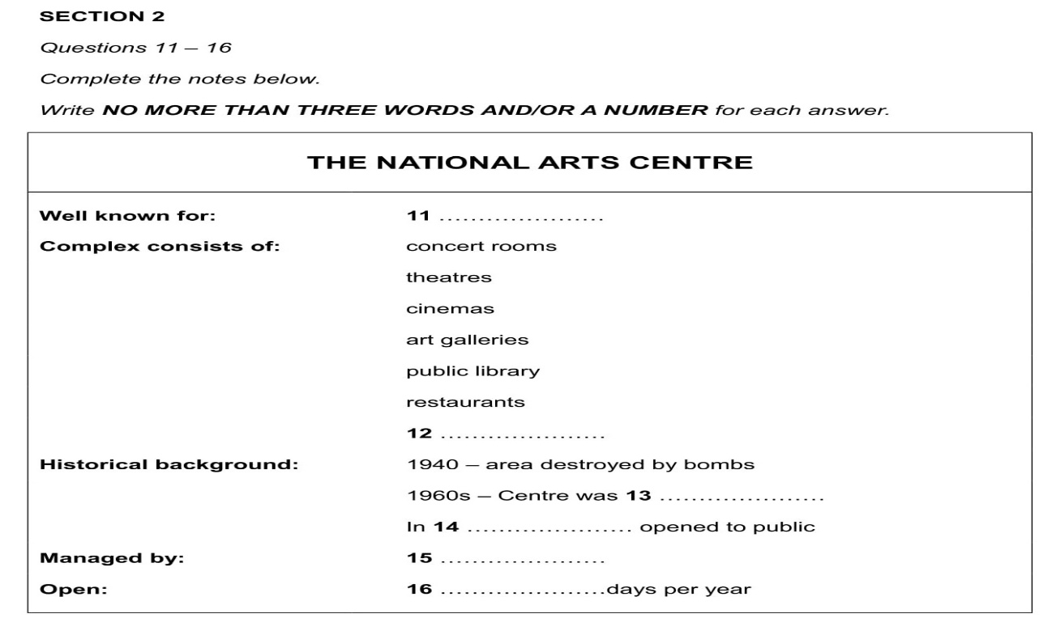
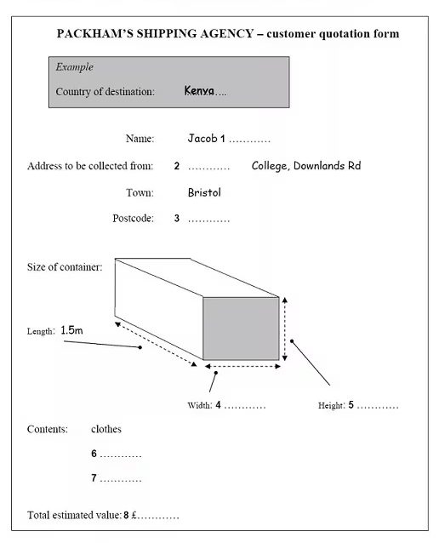
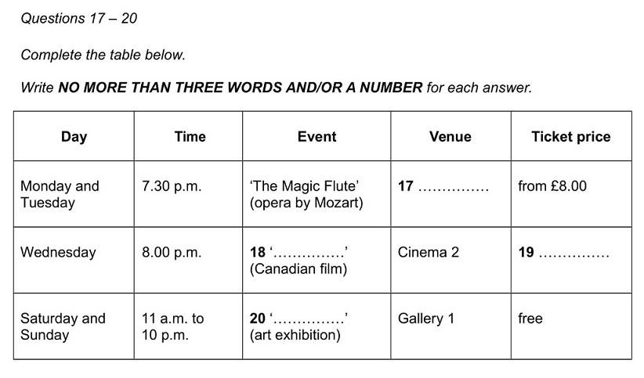
What Are Completion Questions?
“Form, note, and table completion questions require you to write the exact words you hear.They usually test:
Personal details
Practical information
Key facts from a conversation or talk”
“The answers come in the same order as the audio.”
Notes:
“In the previous video, we learned how to deal with multiple choice questions.”
“Now let’s focus on a question type that appears very frequently, especially in Section 1 and Section 3.”
Form, note, and table completion questions in the IELTS Listening test require candidates to write the exact words they hear in the recording. Unlike multiple-choice questions, these tasks focus on your ability to identify specific information and record it accurately.
These questions usually test practical and factual details from a conversation or short talk. For example, you may need to listen for personal details such as names, addresses, or phone numbers. In other cases, the questions may focus on practical information, including dates, prices, locations, or schedules. They can also test key facts or important points mentioned by the speaker during the discussion.
Another helpful feature of these questions is that the answers appear in the same order as the audio. This means that the first blank corresponds to the first piece of relevant information you hear, followed by the next answers in sequence. Understanding this order helps you follow the recording more easily and avoid missing important details.

Slide 3
Step 1: Read the Instructions Carefully
Before listening, always check:
Word limit
Whether numbers are allowed
Singular or plural forms”
For example: ‘NO MORE THAN TWO WORDS AND/OR A NUMBER’”
Breaking this rule automatically loses the mark
Notes:
Before the audio begins, always take a moment to carefully read the instructions for each question. This step may seem simple, but it is extremely important because many students lose easy points by ignoring small details in the instructions.
When checking the instructions, pay attention to a few key things. First, look at the word limit. The instructions will tell you exactly how many words you are allowed to write. If you write more words than allowed, your answer will be marked wrong, even if the information is correct.
Second, check whether numbers are allowed. Some questions allow answers with numbers, while others require only words. Understanding this helps you avoid unnecessary mistakes when writing your answer.
You should also pay attention to singular and plural forms. Sometimes the sentence structure will require a plural noun, and writing the singular form could make the answer grammatically incorrect.
For example, you might see an instruction like: “NO MORE THAN TWO WORDS AND/OR A NUMBER.”
This means your answer can contain one or two words, a number, or a combination of both. However, if you write three words, the answer will automatically be marked wrong.
Because of this, always remember: breaking the instruction rule automatically loses the mark, even if you clearly understood the audio. Taking a few seconds to read the instructions carefully can help you avoid these mistakes and protect your score.

Slide 4
Step 2: Predict the Type of Answer
Use prediction to your advantage.”
Look at each gap and ask:
Is this a name?
A number?
A place?
A noun or adjective?”
This helps you catch the answer even if the speaker talks quickly.”
Example 1: Predicting a Name
Question:
The appointment is booked under the name _______.
Prediction: Ask yourself: What kind of answer fits here? The phrase “under the name” tells you the answer will be a person’s name.
Notes:
Before the audio starts, take a few seconds to look at each gap and try to predict the type of information that might be missing. This strategy is called prediction, and it can help you stay focused and ready for the answer when you hear it.
When you look at the sentence, ask yourself simple questions such as: • Is the answer likely to be a name? • Is it a number, like a date, price, or time? • Could it be a place, such as a city, building, or location? • Does the grammar suggest a noun or an adjective?
By asking these questions, you train your brain to expect a certain type of word or information. This makes it easier to recognize the correct answer when you hear it in the recording.
Prediction is especially helpful when the speaker talks quickly or uses natural conversation speed. Even if the audio moves fast, your mind is already prepared for the kind of answer you need to listen for. As a result, you are more likely to catch the correct word and write it down accurately.
In IELTS Listening, using prediction effectively can help you stay one step ahead of the recording and reduce the chances of missing important information.

Slide 5
Step 3: Write While Listening
You don’t need to write full sentences.Write only the essential words, exactly as you hear them.
Be careful with:
Spelling
Capital letters for names
Singular and plural nouns
If you miss an answer, move on—don’t panic.
Example 1: Writing the Key Word Only
Sentence in the question: Students must bring their ______ to the test.
Audio: “Please remember to bring your passport on the test day.”
Correct answer: passport
❌ Wrong: Students must bring their passport to the test. ✅ Correct: passport
Notes:
When answering IELTS Listening questions, remember that you do not need to write full sentences. Your goal is simply to write the correct word or phrase that completes the gap. Writing full sentences can waste valuable time and may even cause you to miss the next answer.
Instead, focus on writing only the essential words exactly as you hear them in the audio. The listening test moves quickly, so keeping your answers short and precise will help you stay on track with the recording.
However, even though the answers are short, you still need to be careful with a few important details.
First, pay attention to spelling. IELTS Listening is strict about spelling, and a small mistake can cause you to lose the mark. If you are unsure about a word, try to write it as clearly and accurately as possible.
Second, remember to use capital letters for names, such as people, places, or organizations. For example, a person’s name or a city name should always begin with a capital letter.
You should also check singular and plural nouns. Sometimes the correct answer requires an “s” at the end, and forgetting it can make the answer incorrect.
Finally, if you miss an answer, do not panic. The recording will continue, and worrying about one question may cause you to miss the next one. Simply move on and focus on the upcoming answers. Often, staying calm and attentive will help you perform much better throughout the rest of the test.

Slide 6
Advice from IELTS NINER REVIEW CENTER
At IELTS NINER REVIEW CENTER, we train students to:
Write short, clear answers
Check grammar immediately
Review answers quickly at the end
This reduces stress and protects your score.
Notes:
At IELTS NINER REVIEW CENTER, students are trained to use simple but effective strategies to avoid losing easy points in the IELTS Listening test.
First, students learn to write short and clear answers. Instead of writing long phrases or full sentences, they focus only on the exact word or phrase needed to complete the gap. This helps them keep up with the recording and avoid missing the next answer.
Second, students are trained to check grammar immediately after writing their answer. Even though listening answers are short, small grammar details still matter. For example, students quickly check if the answer should be singular or plural, if the spelling is correct, and if a capital letter is needed for names or places.
Finally, students practice how to review their answers quickly at the end of the test. During the short checking time, they look for common mistakes such as spelling errors, missing letters, or answers that may exceed the word limit in the instructions.
These simple habits help students stay organized and confident during the test. By writing clearly, checking grammar quickly, and reviewing answers at the end, students can reduce stress and protect their IELTS score.

Slide 7

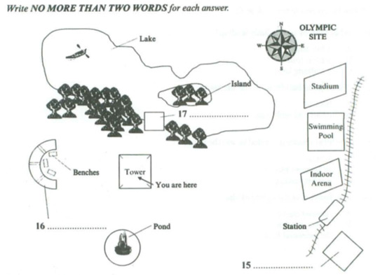
Add a Slide Title - 1
Notes:
“Now that you know how to handle completion questions, let’s move to a more visual challenge.”
“In the next video, we’ll cover: 👉 Map and Diagram Labelling in IELTS Listening—and how to follow directions accurately.”
“See you in the next video.”

